Slide 1
Distributed Systems
Distributed
Object-Based Systems
Chapter 10

Slide 2
Course/Slides Credits
Note: all course presentations are based on those developed by Andrew S. Tanenbaum and Maarten van Steen. They accompany their "Distributed Systems: Principles and Paradigms" textbook (1st & 2nd editions).
http://www.prenhall.com/divisions/esm/app/author_tanenbaum/custom/dist_sys_1e/index.html
And additions made by Paul Barry in course CW046-4: Distributed Systems
http://glasnost.itcarlow.ie/~barryp/net4.html

Slide 3
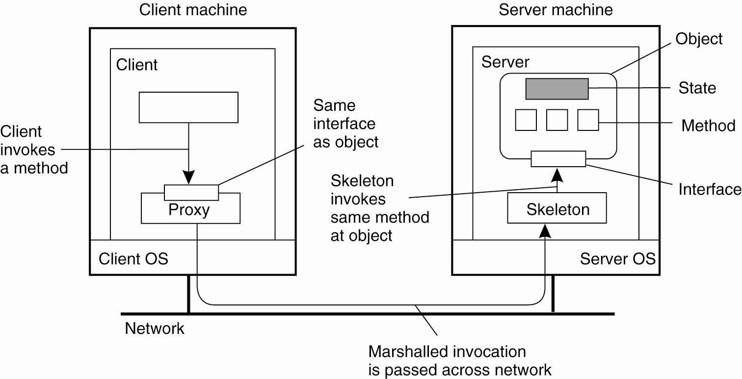
Distributed Objects
Common organization of a remote
object with client-side proxy

Slide 4
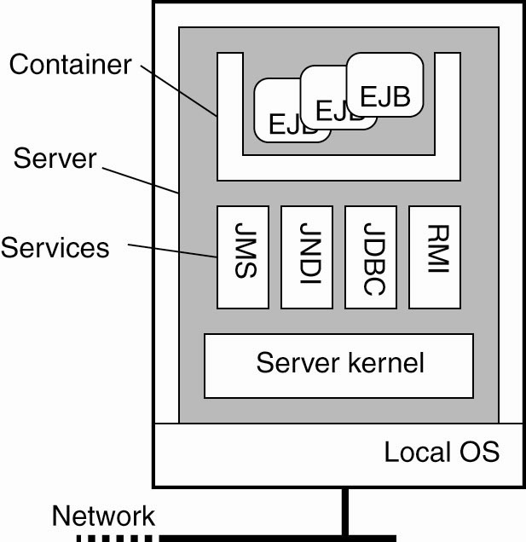
Example: Enterprise Java Beans (EJB)
General architecture of an EJB server

Slide 5
Four Types of EJBs
Stateless session beans
Stateful session beans
Entity beans
Message-driven beans

Slide 6
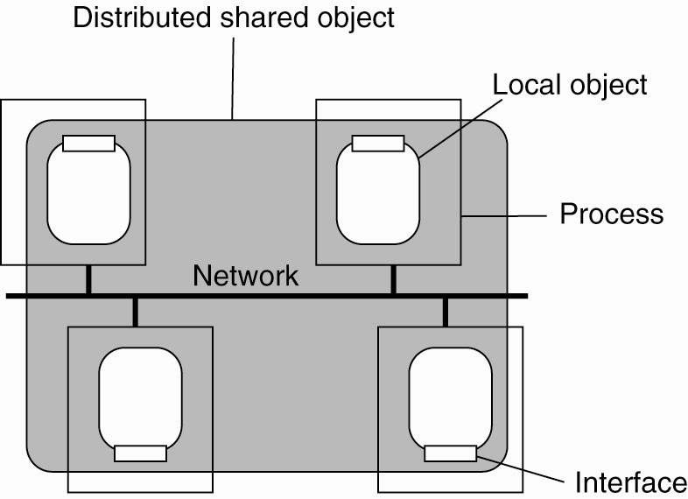
Globe Distributed Shared Objects (1)
The organization of a Globe distributed shared object

Slide 7
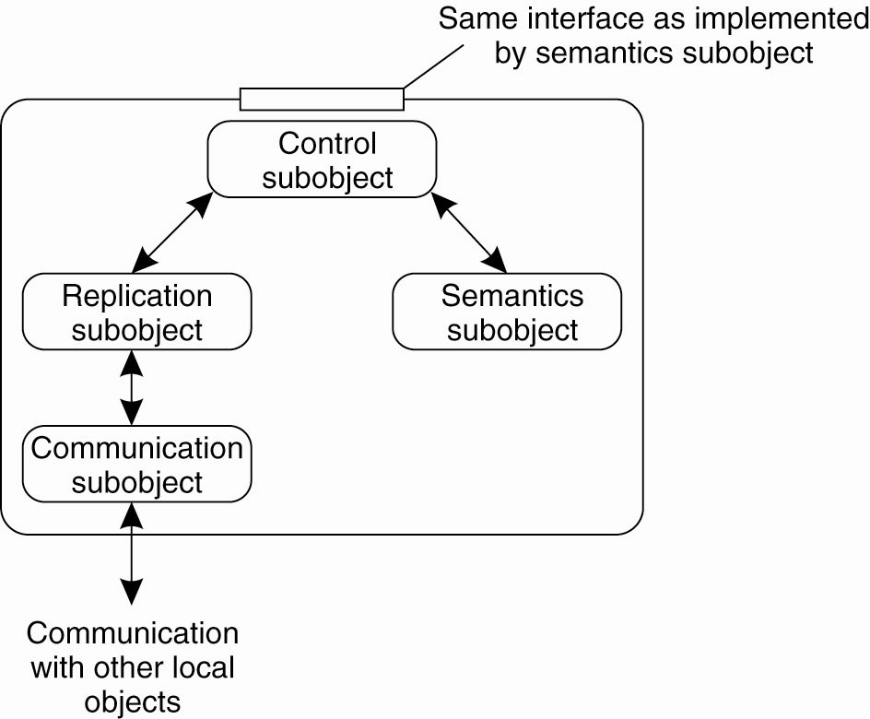
Globe Distributed Shared Objects (2)
The general organization of a local object for distributed shared objects in Globe

Slide 8
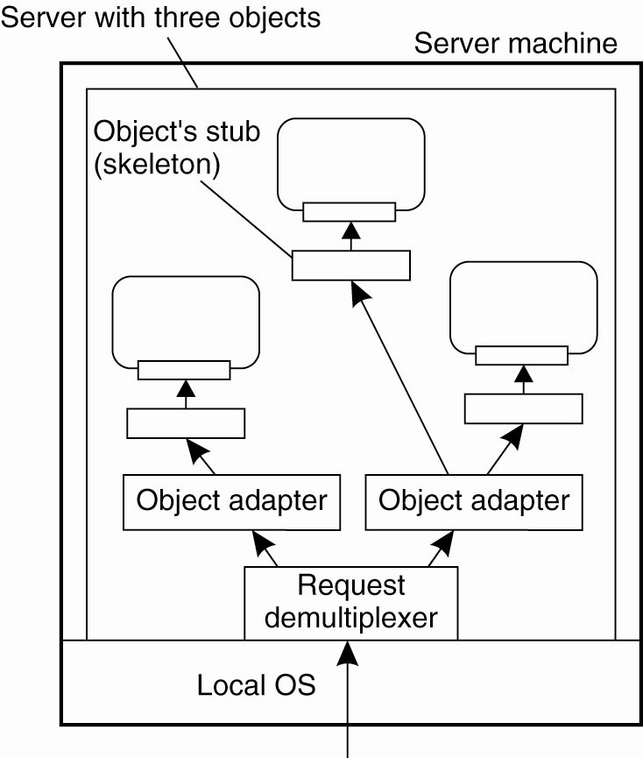
Object Server/Adapter
Organization of an object server
supporting different activation policies

Slide 9
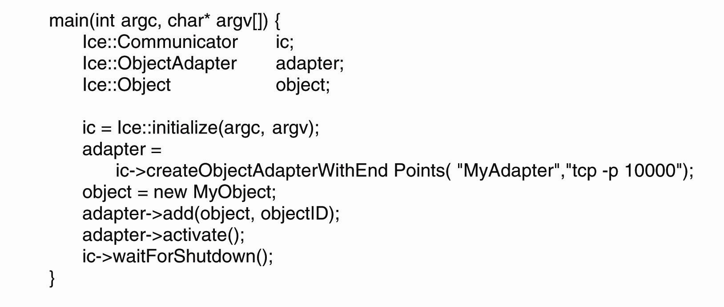
Example: The Ice Runtime System
Example of creating an object server in Ice

Slide 10
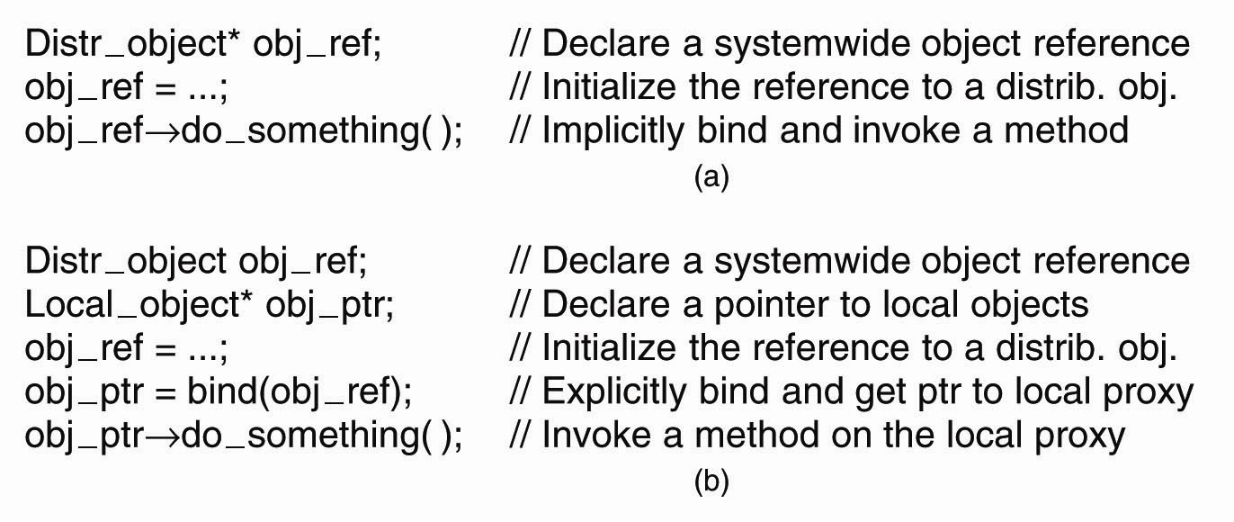
Binding a Client to an Object
(a) An example with implicit binding using only global references. (b) An example with explicit binding using global and local references.

Slide 11
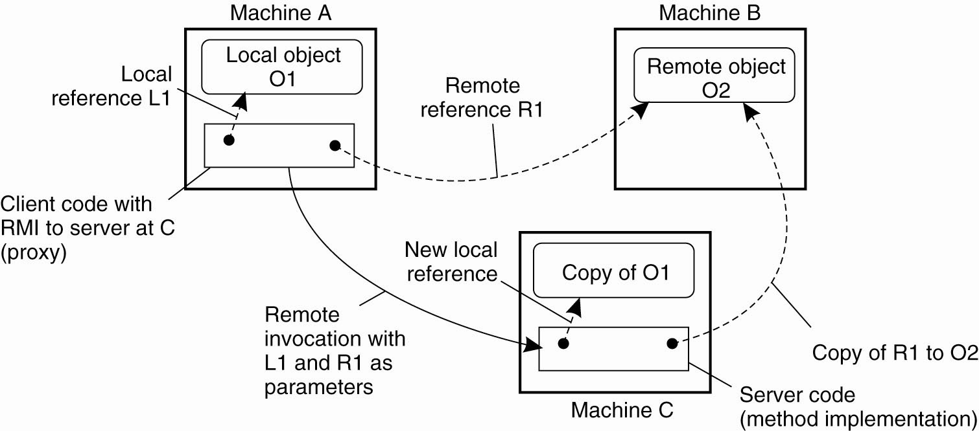
Parameter Passing
The situation when passing an object
by reference or by value

Slide 12
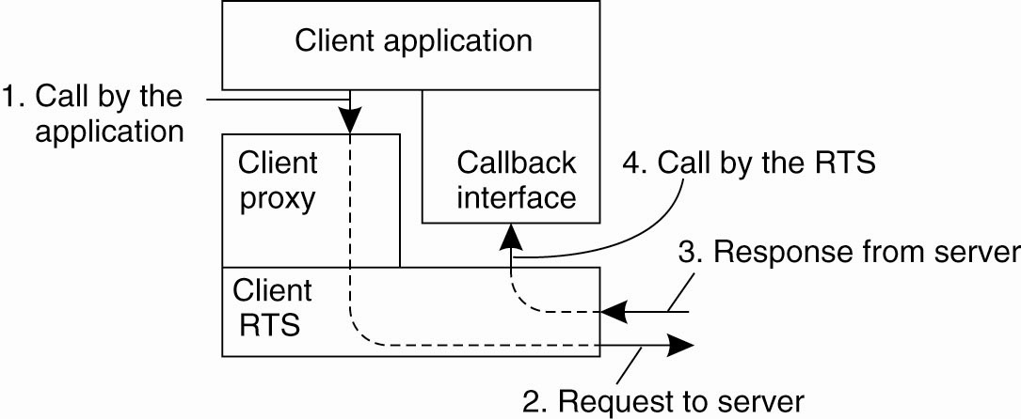
Object-Based Messaging (1)
CORBA’s callback model for
asynchronous method invocation

Slide 13
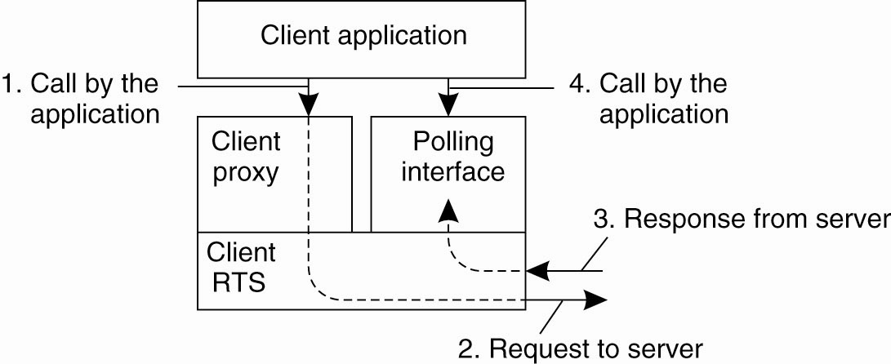
Object-Based Messaging (2)
CORBA’s polling model for
asynchronous method invocation

Slide 14
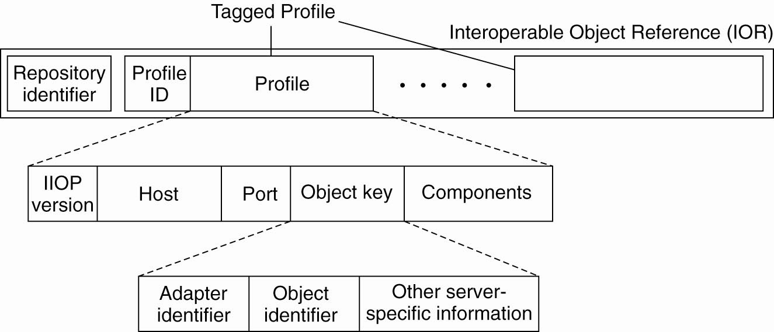
CORBA Object References
The organization of an IOR with
specific information for IIOP

Slide 15
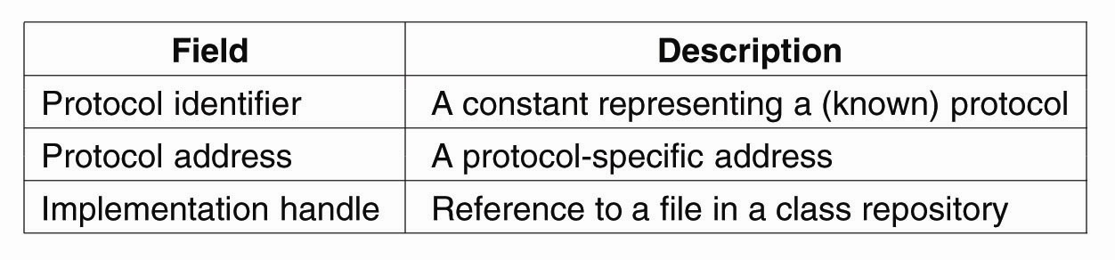
Globe Object References (1)
The representation of a protocol
layer in a stacked contact address

Slide 16
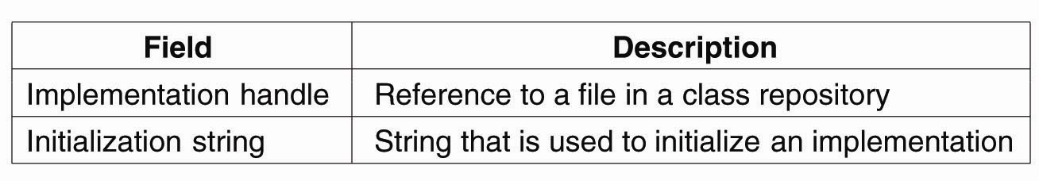
Globe Object References (2)
The representation of an instance contact address

Slide 17
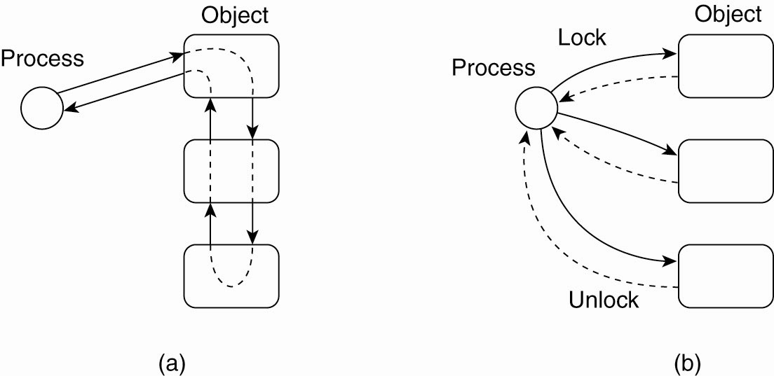
Synchronization
Differences in control flow for locking objects

Slide 18
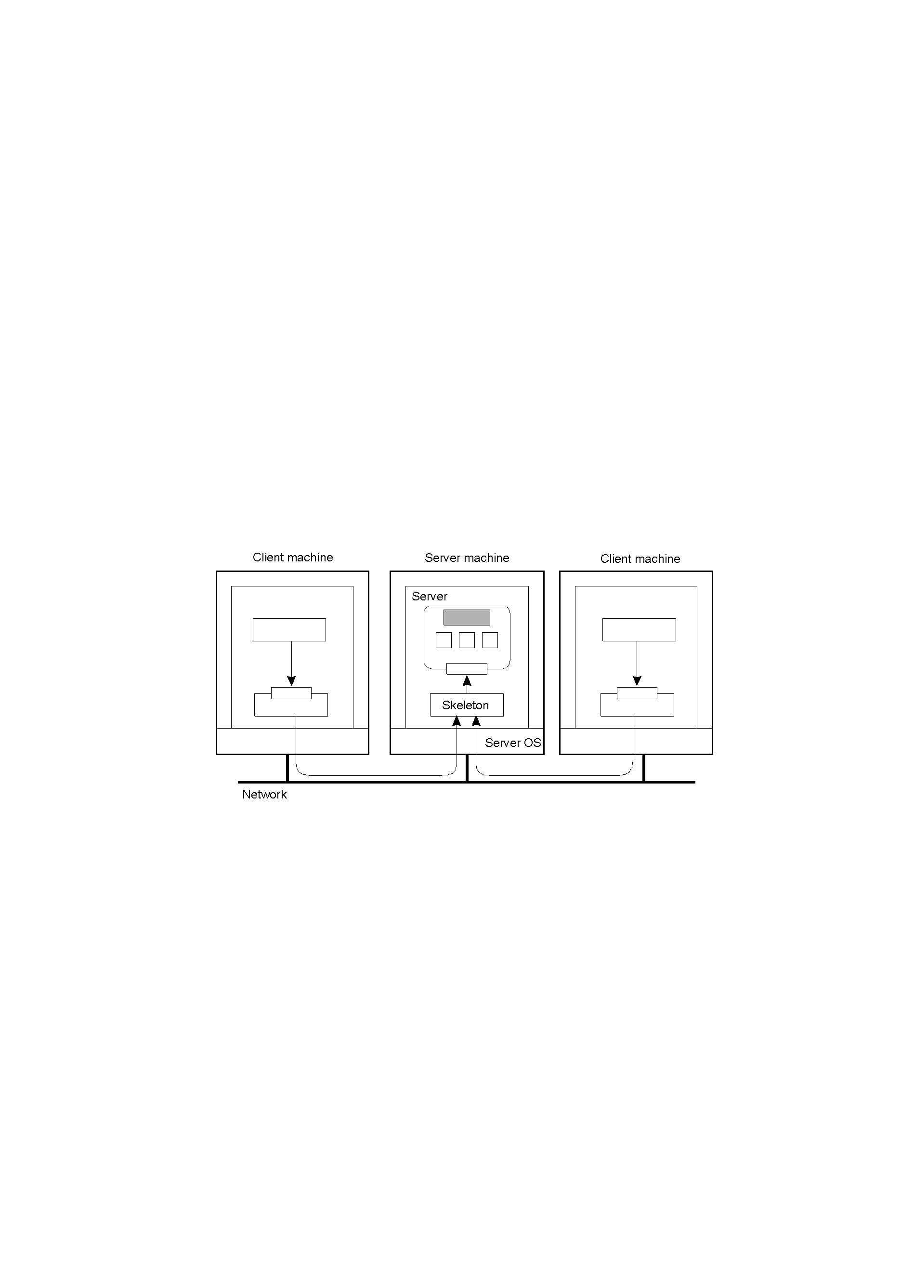
Concurrent Object Access: Problem
Organization of a distributed remote object shared by two different clients. But, how do we protect the object in the presence of multiple simultaneous access?

Slide 19
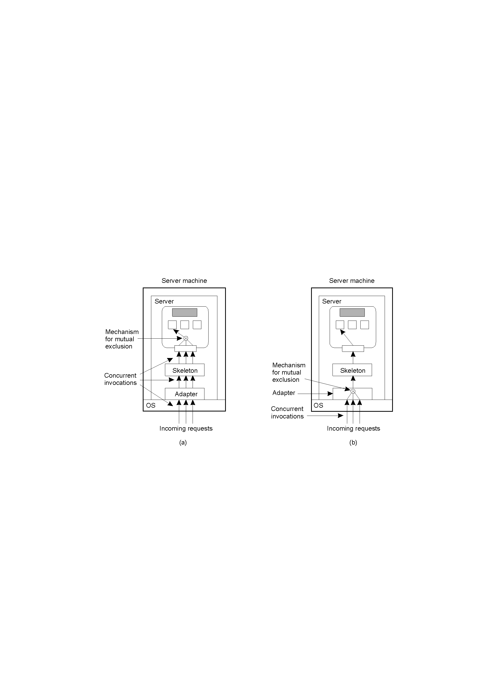
Concurrent Object Access: Solutions
A remote object capable of handling concurrent invocations on its own.
A remote object for which an object adapter is required to handle concurrent invocations (relies on middleware).

Slide 20
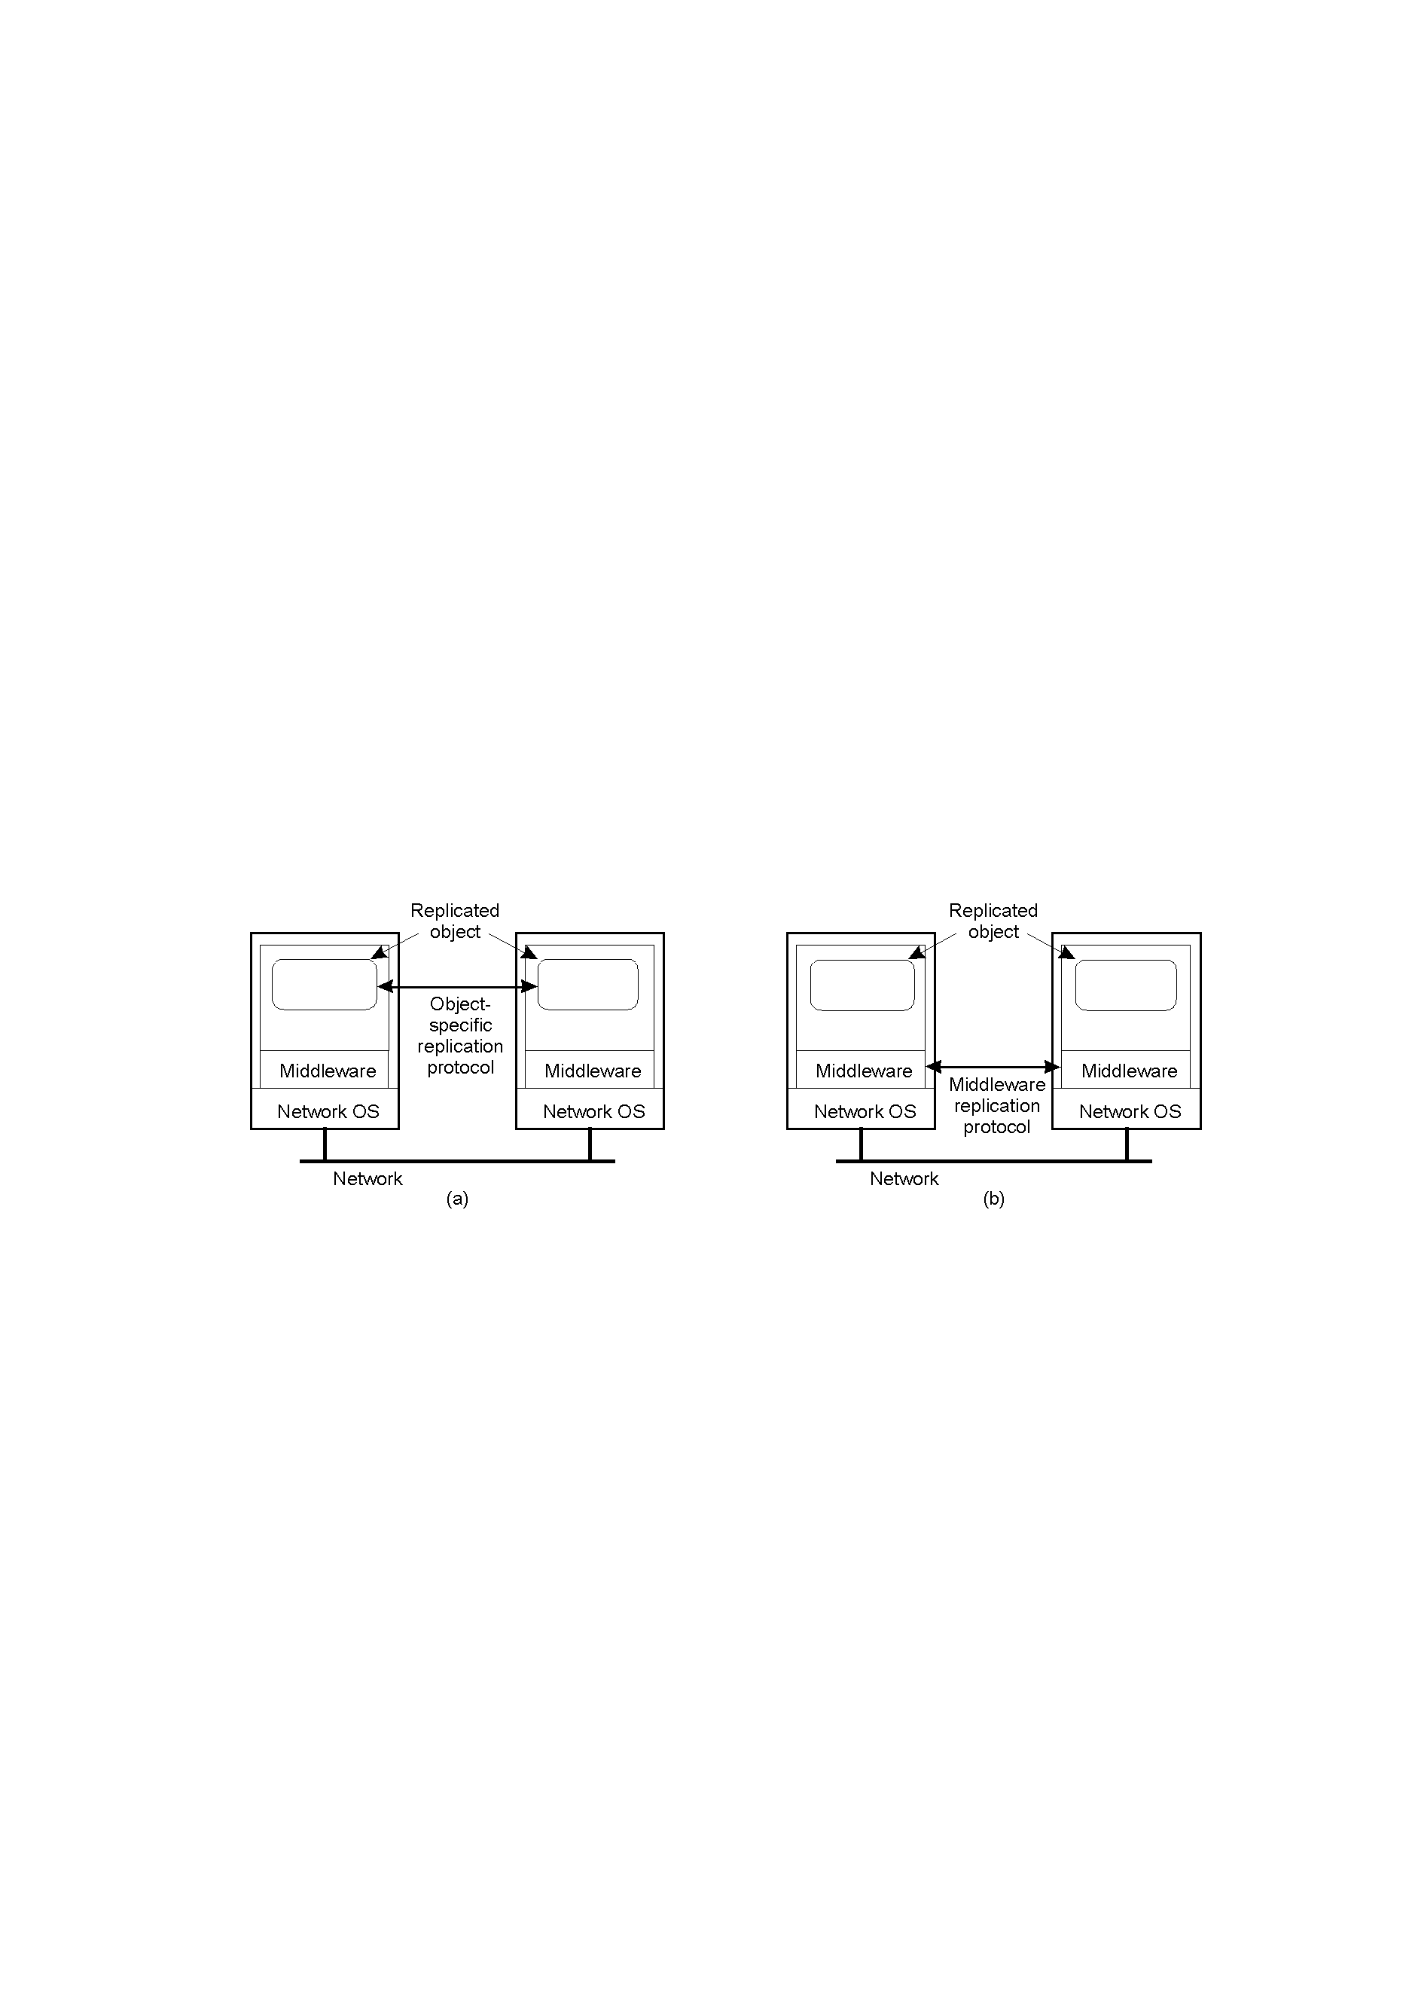
Object Replication: Solutions
A distributed system for replication-aware distributed objects – the object itself is “aware” that it is replicated. This is a very flexible set-up, but can be costly in that the DS developer has to concern themselves with replication/consistency.
A distributed system responsible for replica management – less flexible, but removes burden from the DS developer. The most common approach.

Slide 21
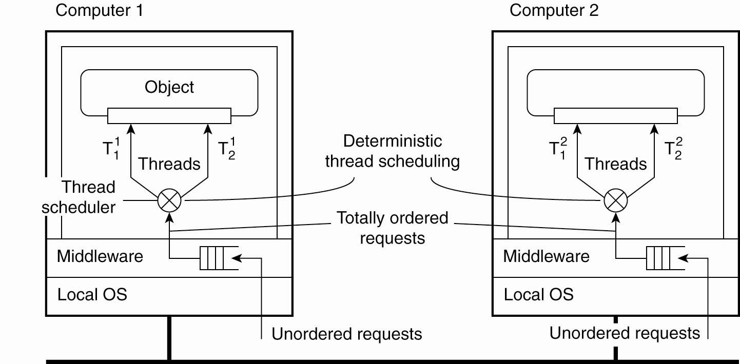
Entry Consistency
Deterministic thread scheduling
for replicated object servers

Slide 22
Replication Frameworks (1)
Invocations to objects are intercepted at three different points:
At the client side just before the invocation is passed to the stub.
Inside the client’s stub, where the interception forms part of the replication algorithm.
At the server side, just before the object is about to be invoked.

Slide 23
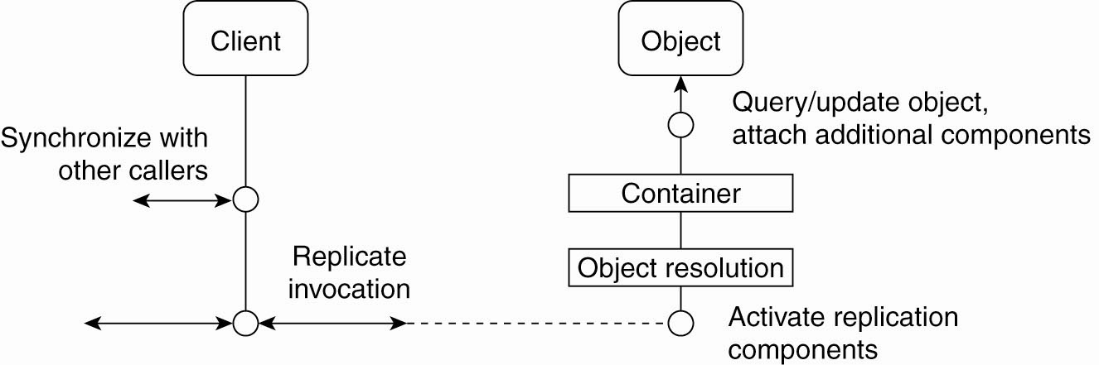
Replication Frameworks (2)
A general framework for separating replication algorithms from objects in EJB environment

Slide 24
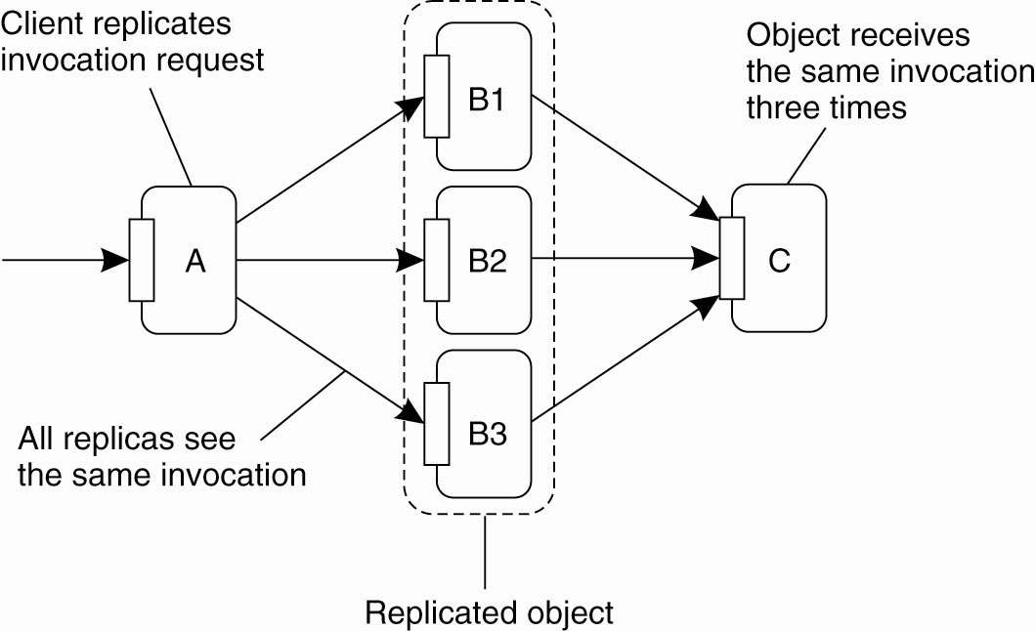
Replicated Invocations (1)
The problem of replicated method invocations

Slide 25
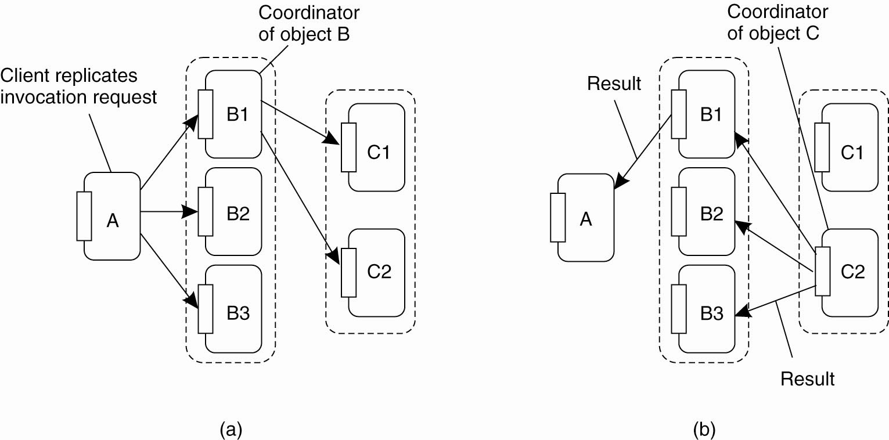
Replicated Invocations (2)
(a) Forwarding an invocation request from a replicated object to another replicated object

Slide 26
Replicated Invocations (3)
(b) Returning a reply from one replicated object to another

Slide 27
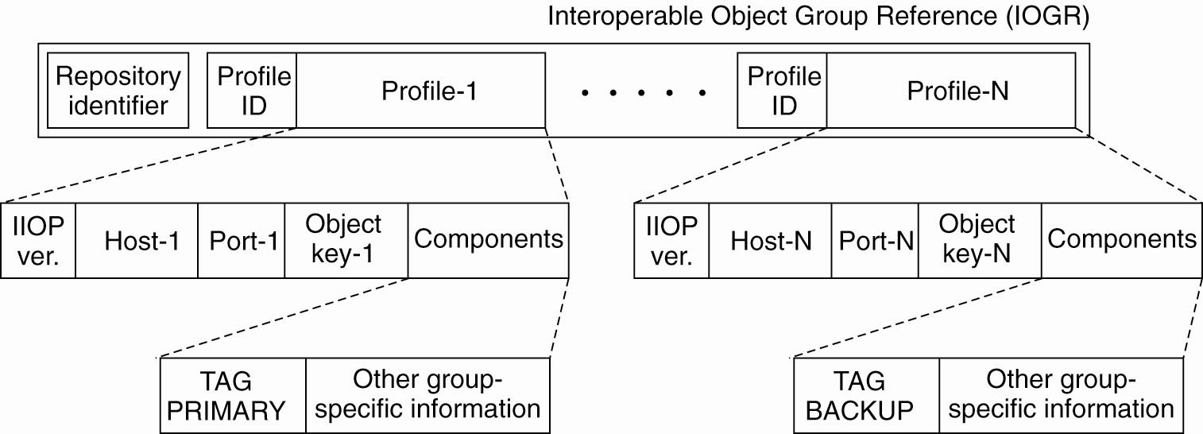
Example: Fault-Tolerant CORBA
A possible organization of an IOGR for an object group having a primary and backups

Slide 28
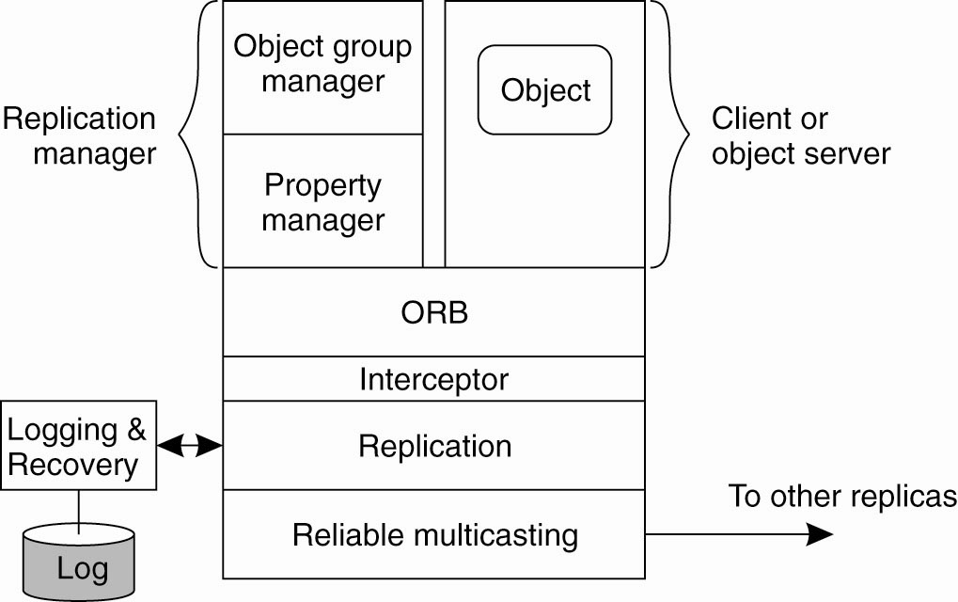
An Example Architecture
An example architecture of a
fault-tolerant CORBA system

Slide 29
Example: Fault-Tolerant Java
Causes for nondeterministic behavior:
JVM can execute native code, that is, code that is external to the JVM and provided to the latter through an interface.
Input data may be subject to non-determinism.
In the presence of failures, different JVMs will produce different output revealing that the machines have been replicated.

Slide 30
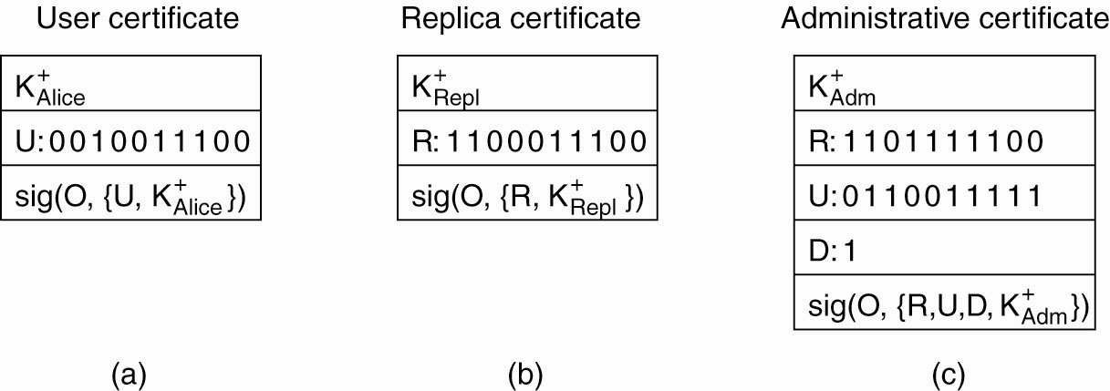
Overview of Globe Security
Certificates in Globe: (a) a user certificate,
(b) a replica certificate, (c) an administrative certificate.

Slide 31
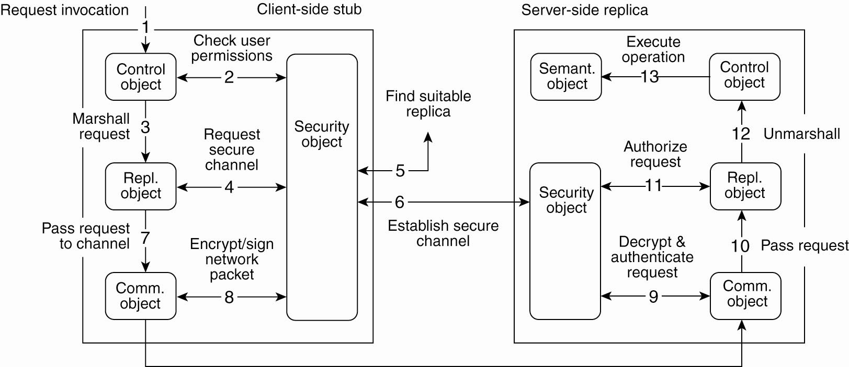
Secure Method Invocation (1)
Secure method invocation in Globe

Slide 32
Secure Method Invocation (2)
Steps for securely invoking a method of a Globe object:
Application issues a invocation request by locally calling the associated method
Control sub-object checks the user permissions with the information stored in
the local security object.
Request is marshaled and passed on.
Replication sub-object requests the middleware to set up a secure channel to a suitable replica.

Slide 33
Secure Method Invocation (3)
Security object first initiates a replica lookup.
Once a suitable replica has been found, security sub-object can set up a secure channel with its peer, after which control is returned to the replication sub-object.
Request is now passed on to the communication sub-object.
Sub-object encrypts and signs the request so that it can pass through the channel.

Slide 34
Secure Method Invocation (4)
After its receipt, the request is decrypted and authenticated.
Request then passed on to the server-side replication sub-object.
Authorization takes place:
Request is then unmarshaled.
Finally, the operation can be executed.

